Slide 1
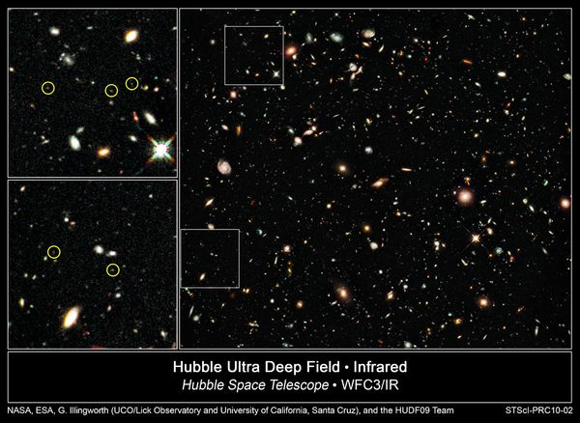
Notes:
What are these dots? (Galaxies – very distant ones)
How do know: how can we try to understand what is going on in such distant objects?

Slide 2
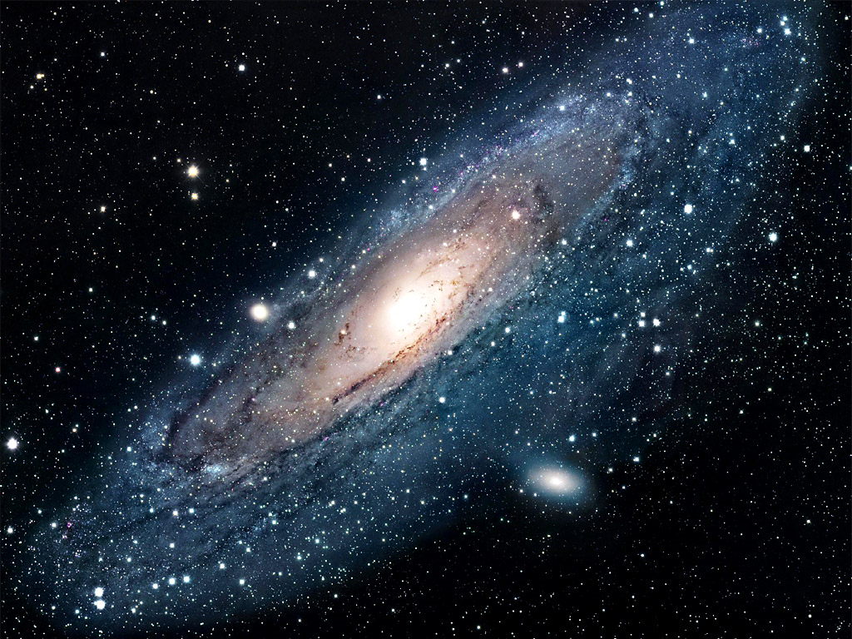
Notes:
Lots of stars in galaxies, lots of galaxies!

Slide 3
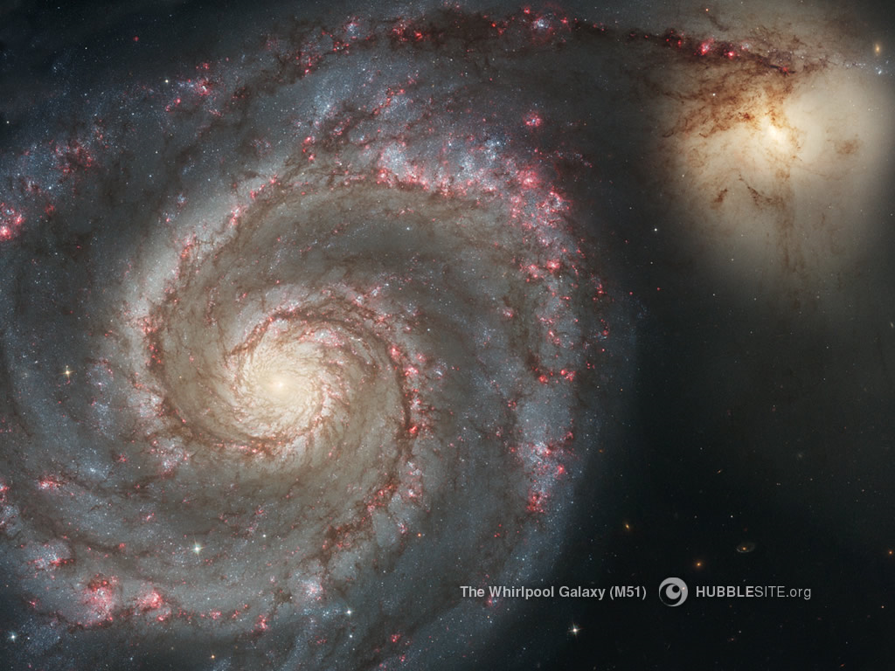

Slide 4
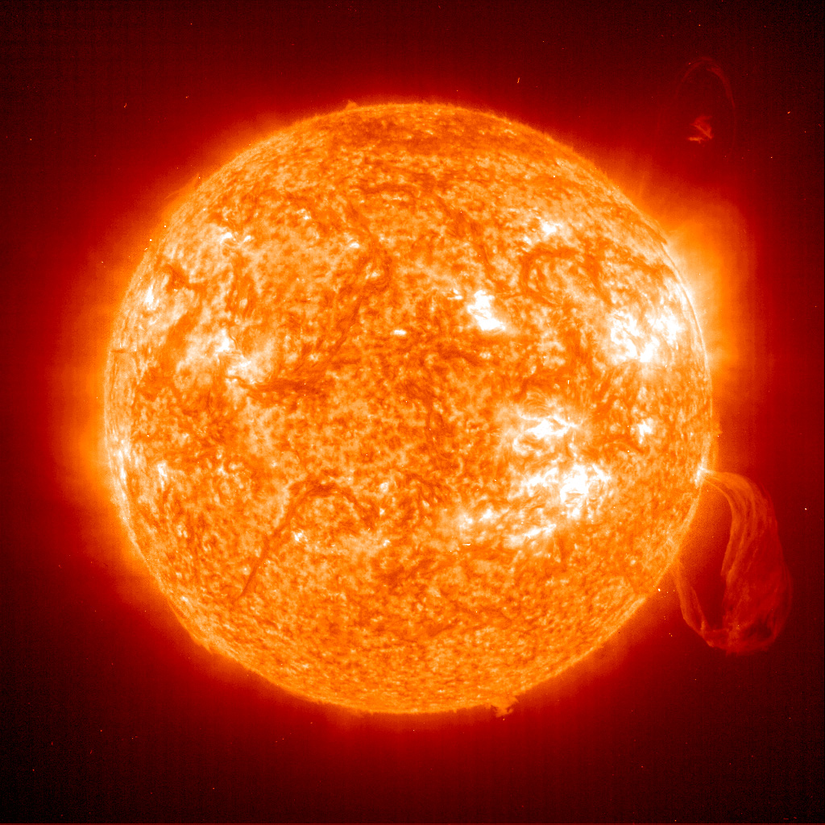
Notes:
The Sun – in X-ray image

Slide 5
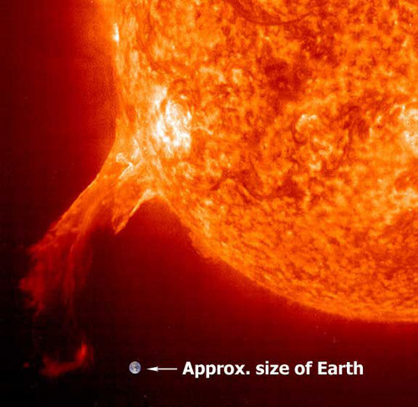

Slide 6
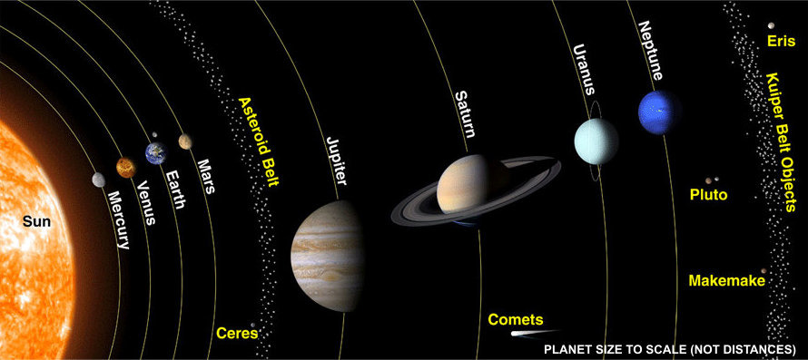

Slide 7
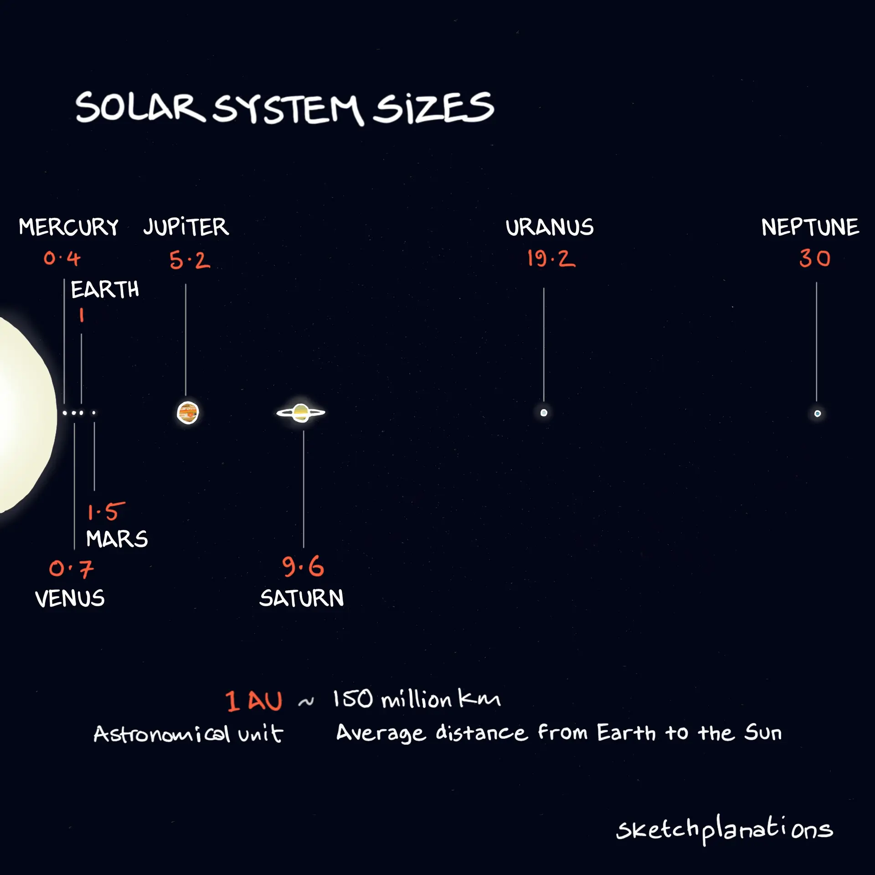

Slide 8
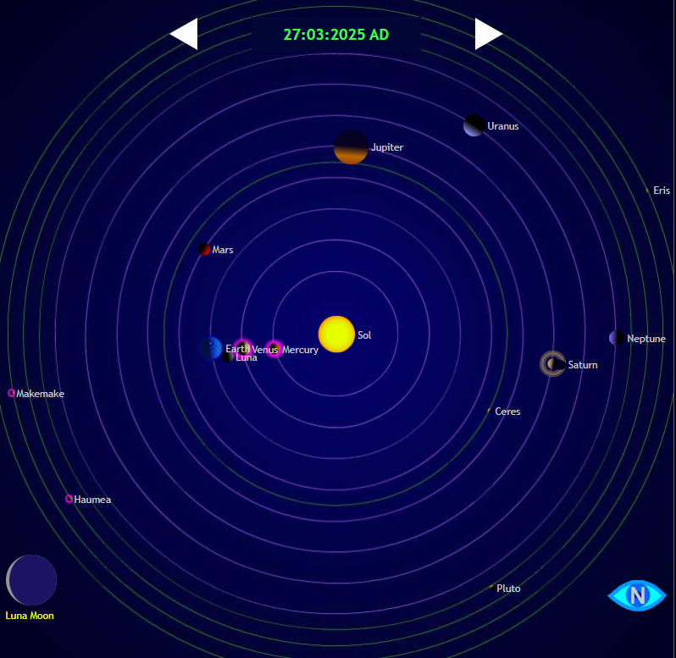

Slide 9
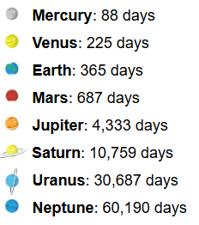

Slide 10
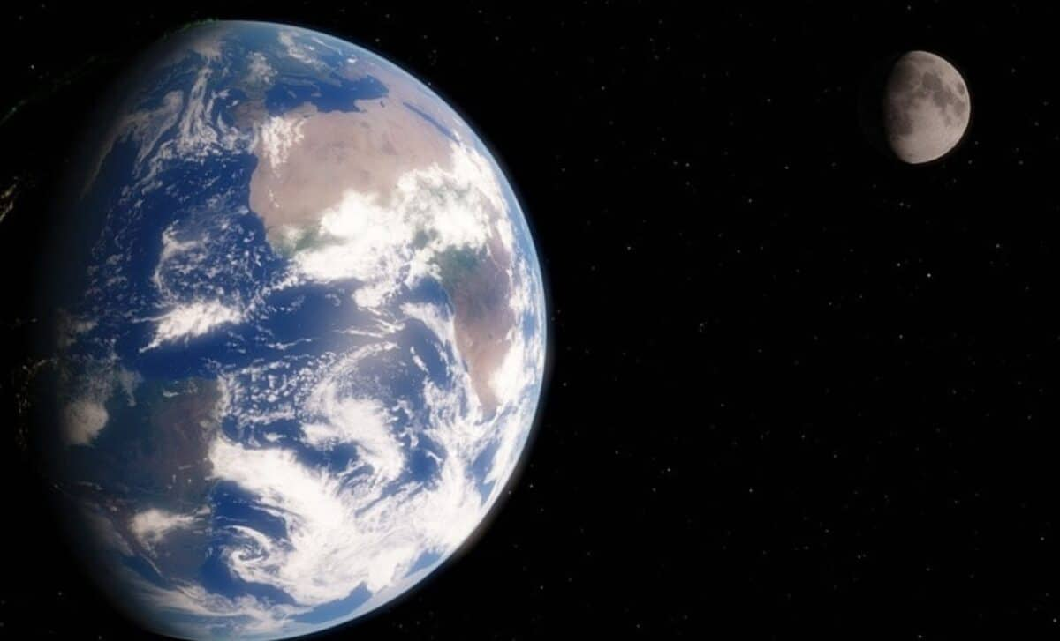

Slide 11
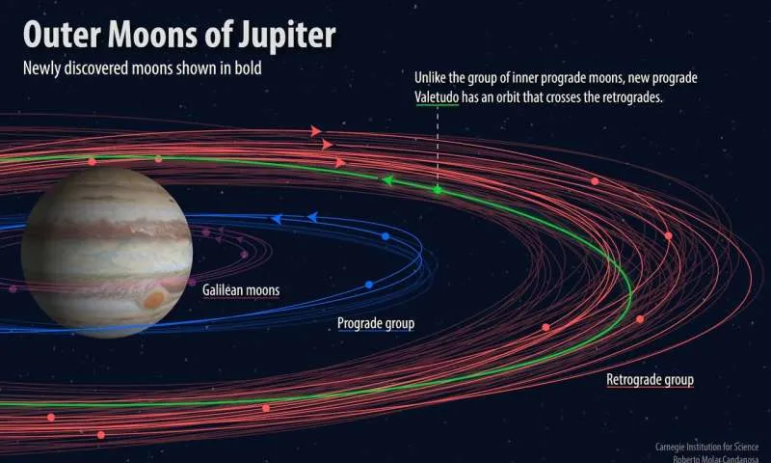

Slide 12
Where does the sun get its energy from?

Slide 13
Nuclear fusion
4 hydrogen nuclei
→
1 helium nucleus

Slide 14
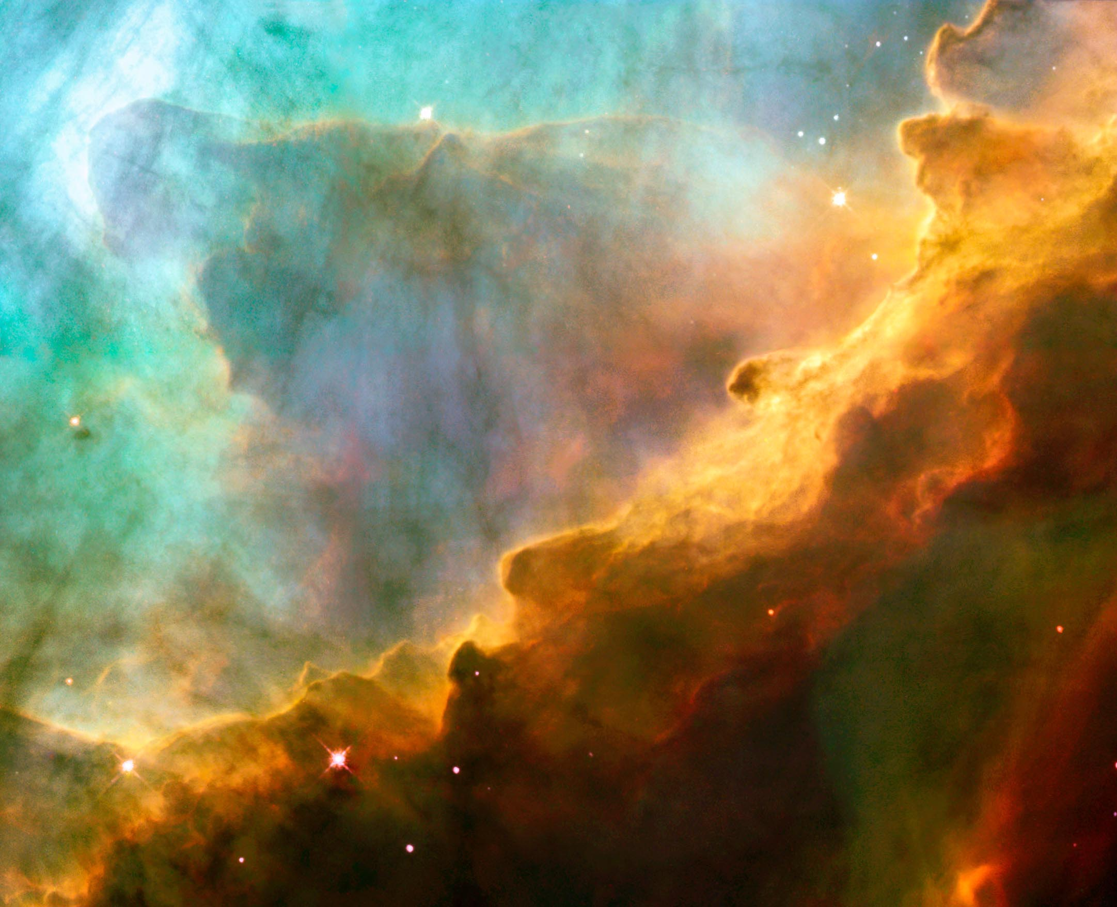
The Omega Nebula – a stellar nursery

Slide 15
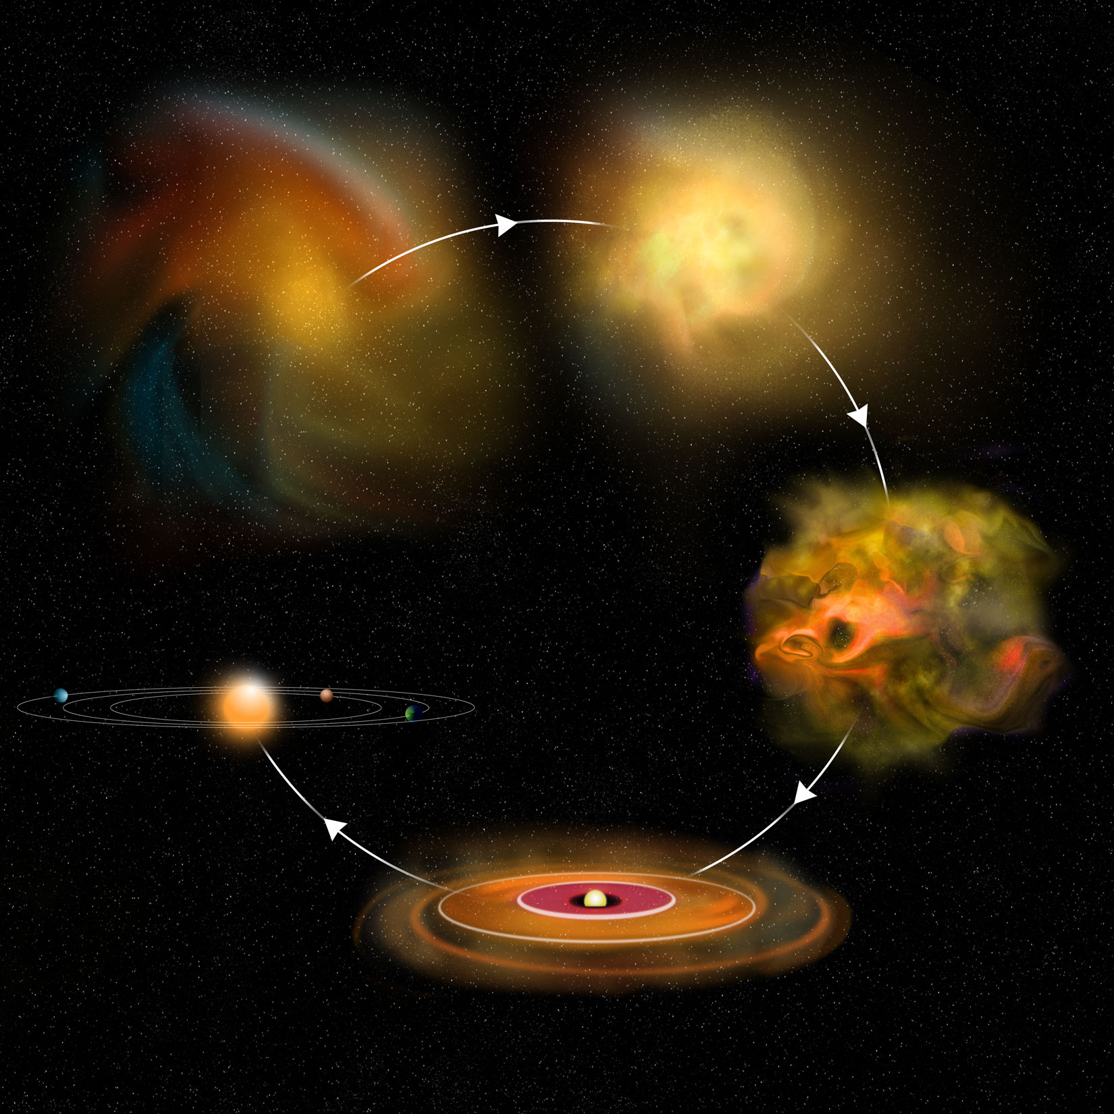
Notes:
Star formation

Slide 16
Why does gravity not cause the star to go on collapsing?
Notes:
The Sun – in X-ray image

Slide 17
All stable stars are in equilibrium:
radiation pressure = gravitational force
Notes:
The Sun – in X-ray image

Slide 18
What happens when much of the hydrogen in the core of the star has been used up?

Slide 19
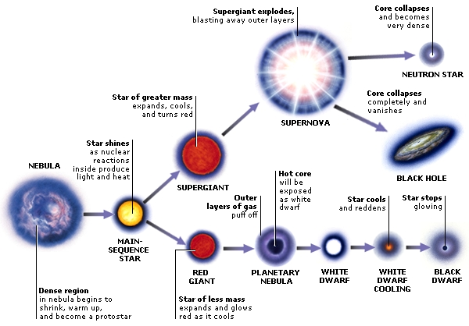

Slide 20
Let us look at some details:
firstly for a star about the same size as the Sun

Slide 21
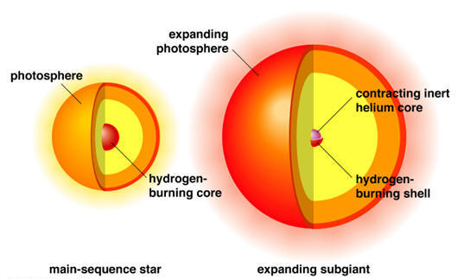
Main sequence small star…. Becomes red giant star
Notes:
Red Giant forming

Slide 22
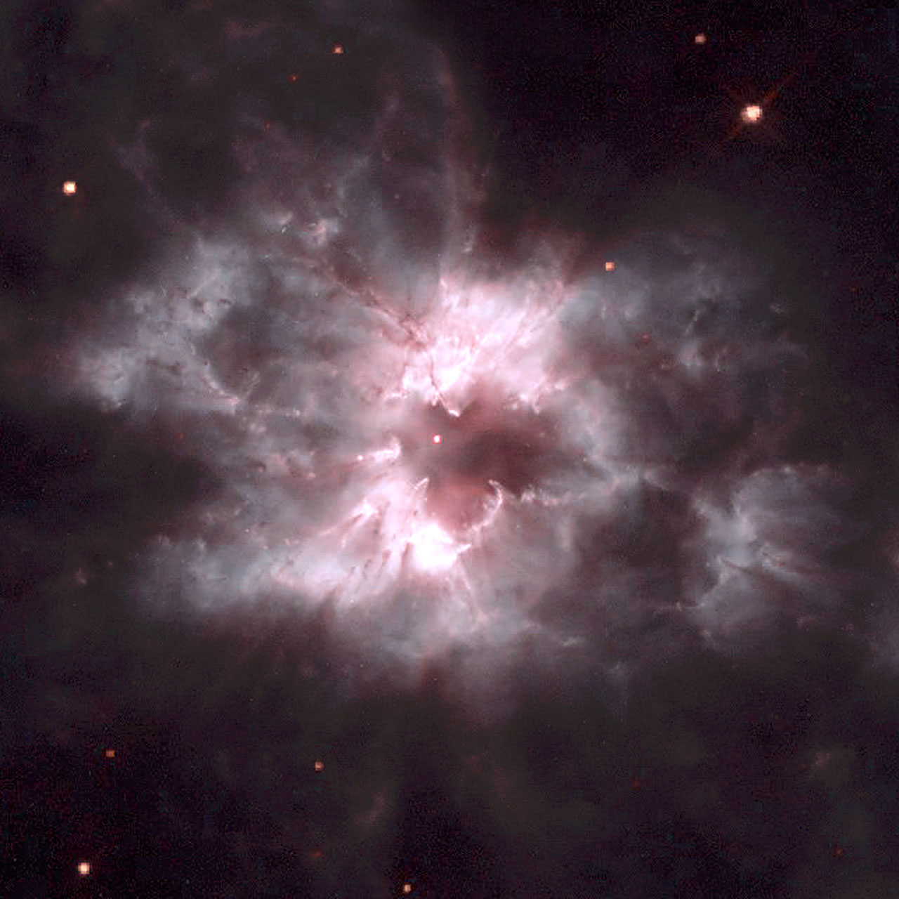
Planetary nebula surrounding white dwarf

Slide 23
then for a star much bigger than the Sun
(mass > 10 solar masses)

Slide 24
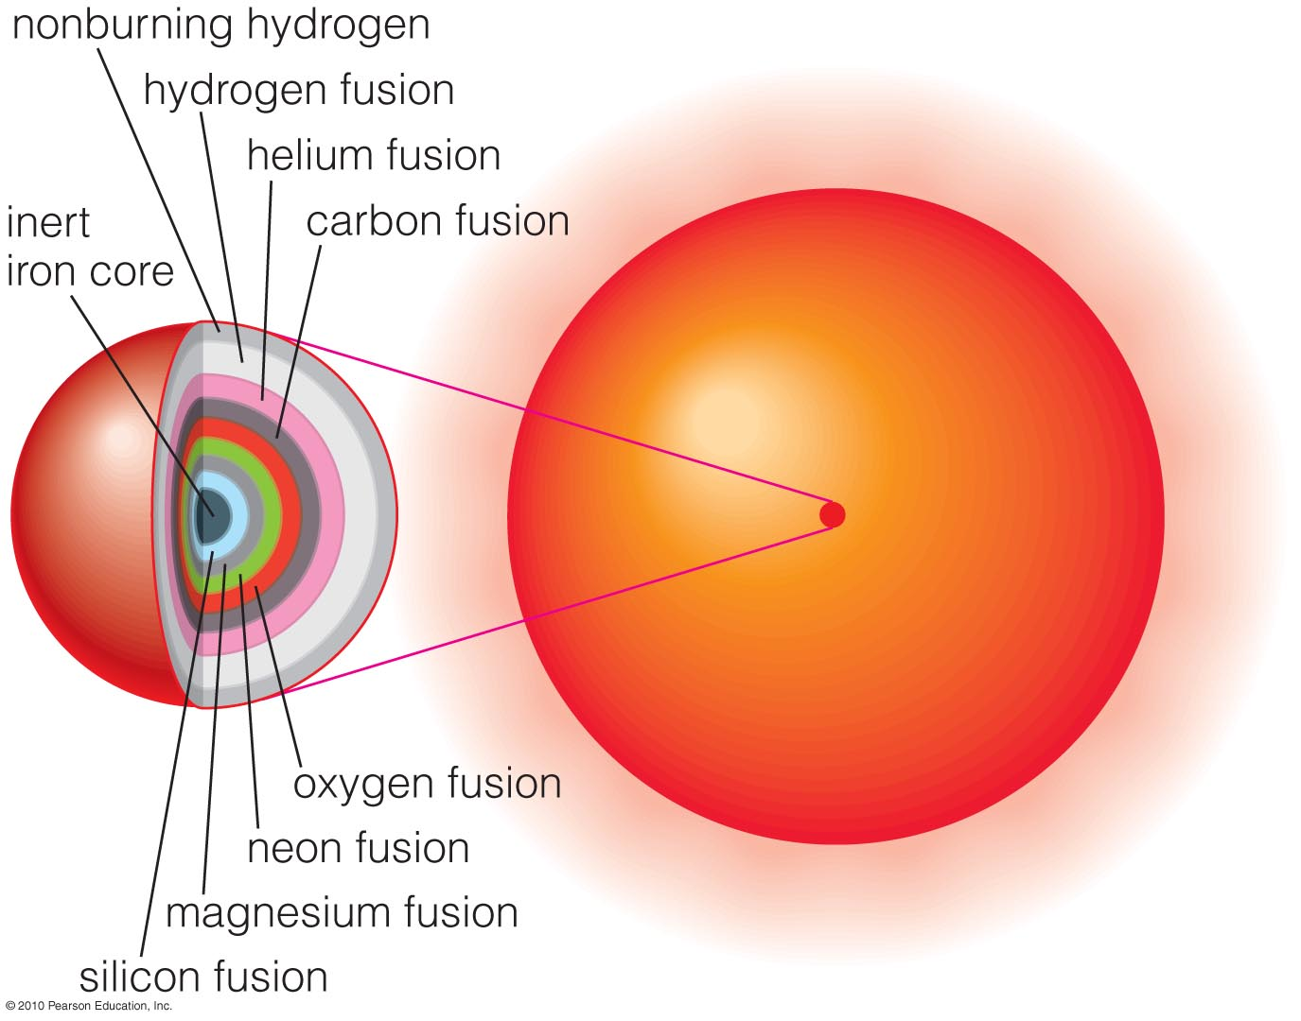
Old, high mass star

Slide 25
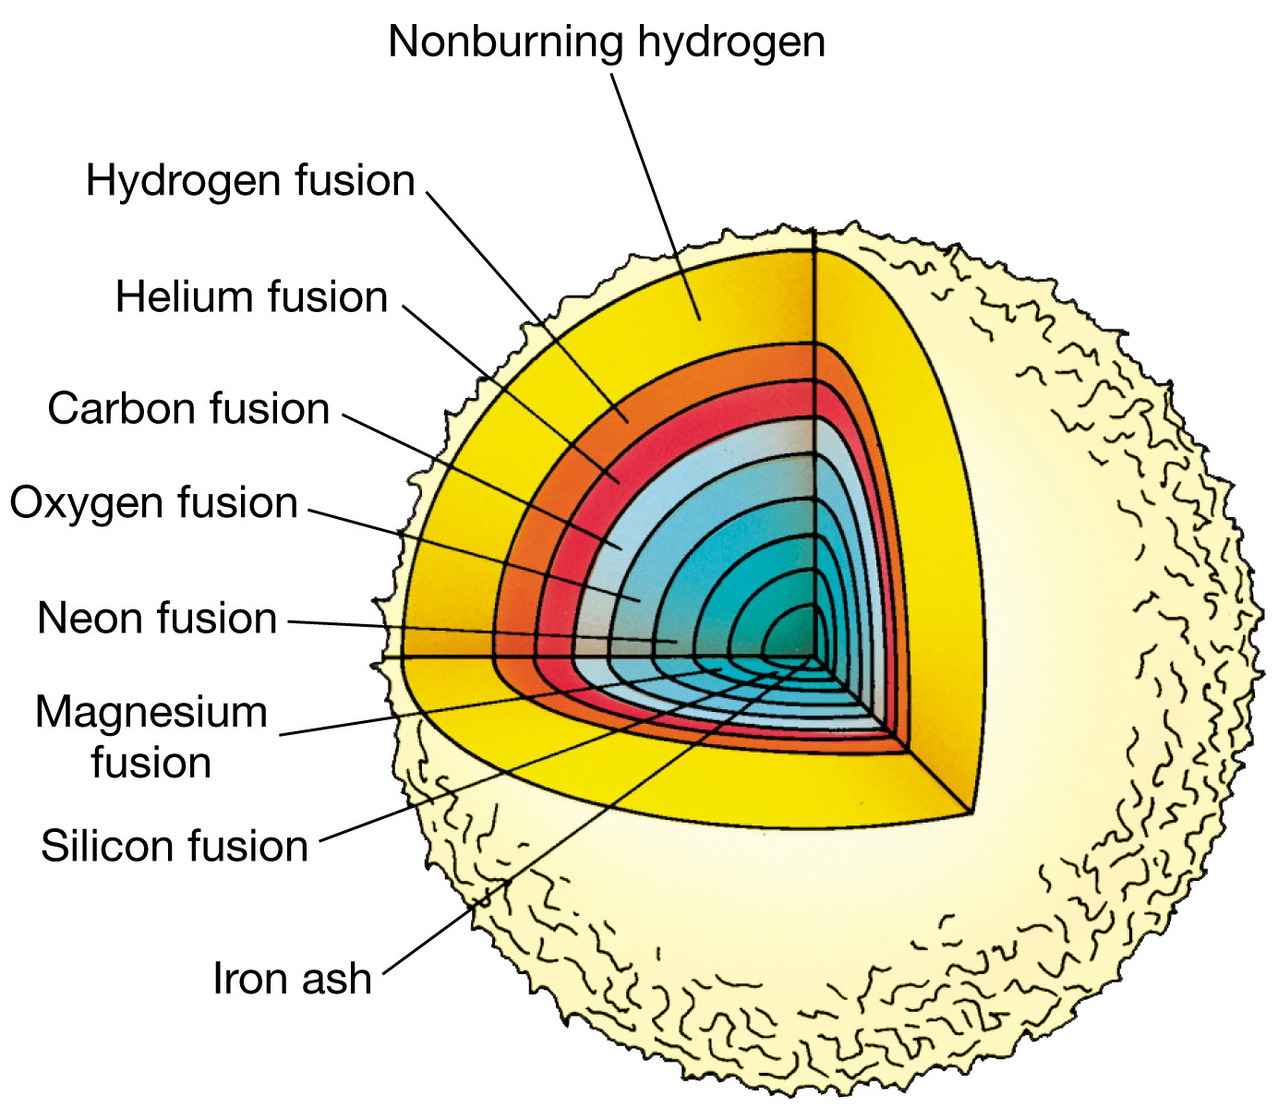

Slide 26
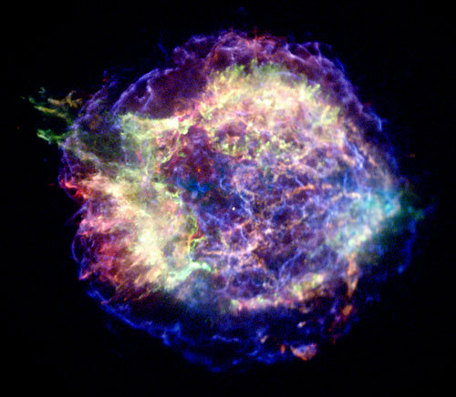
Supernova

Slide 27
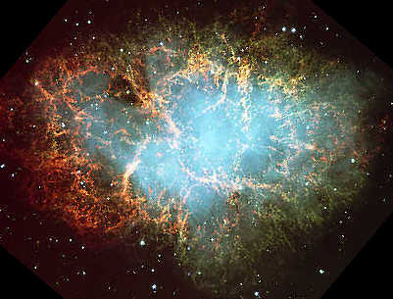
The Crab Nebula
1054

Slide 28
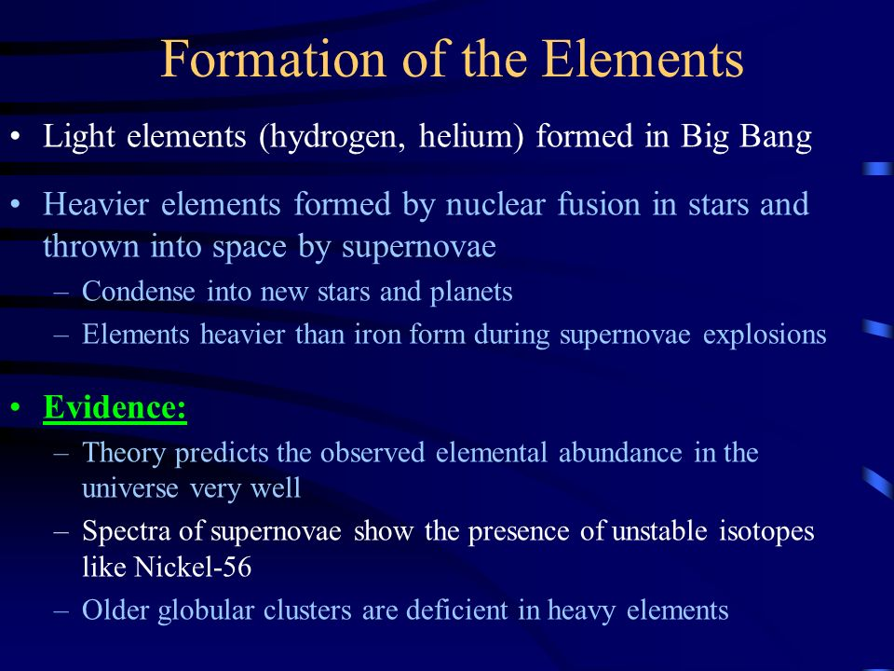

Slide 29
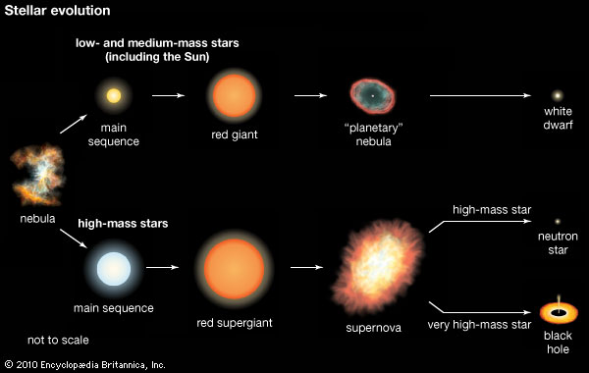

Slide 30
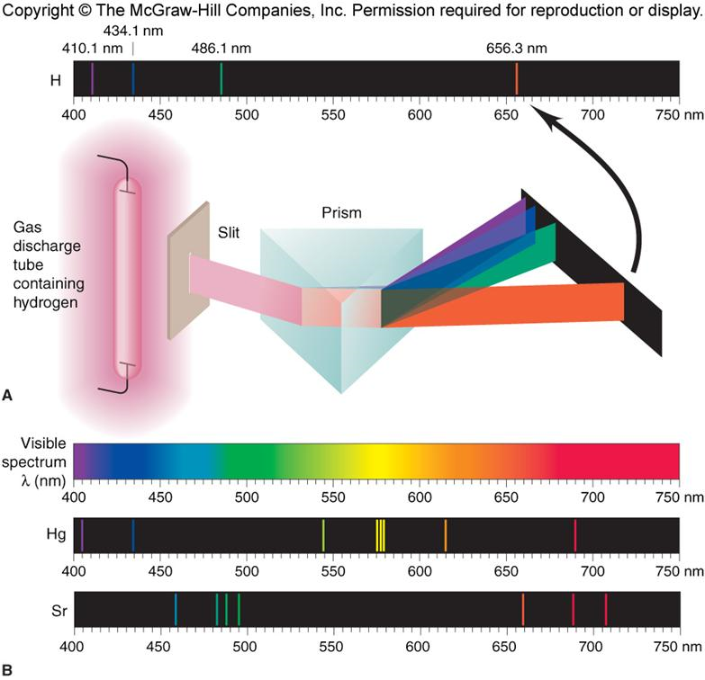

Slide 31
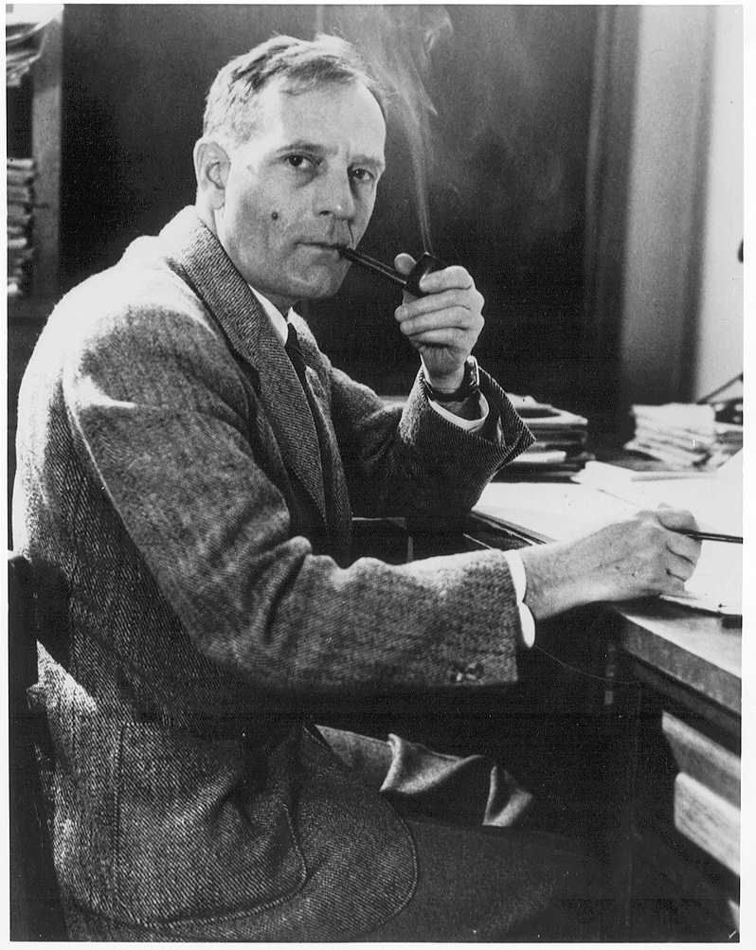
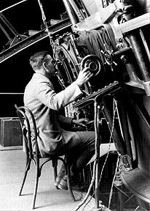
Edwin Hubble

Slide 32
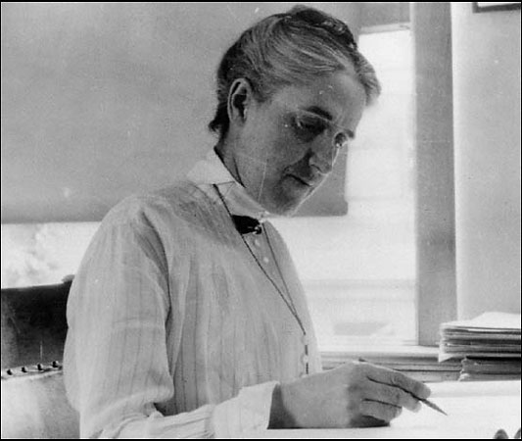
Henrietta Swan Leavitt

Slide 33
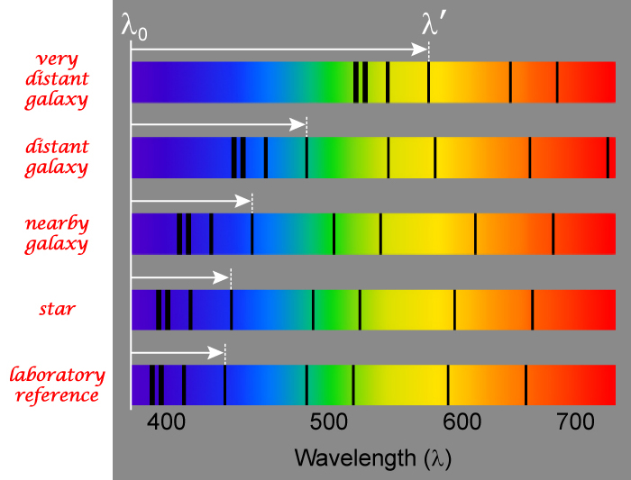

Slide 34
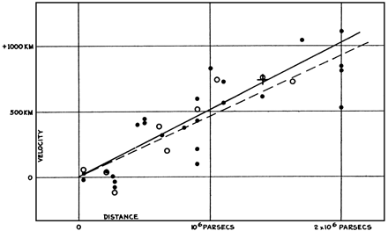
In 1929, Hubble looked at the spectra of 24 bright galaxies at different distances from the Earth. He found that their spectra were all red-shifted, and that the further away the galaxy was, the greater its red-shift.

Slide 35

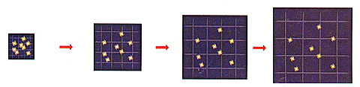

Slide 36
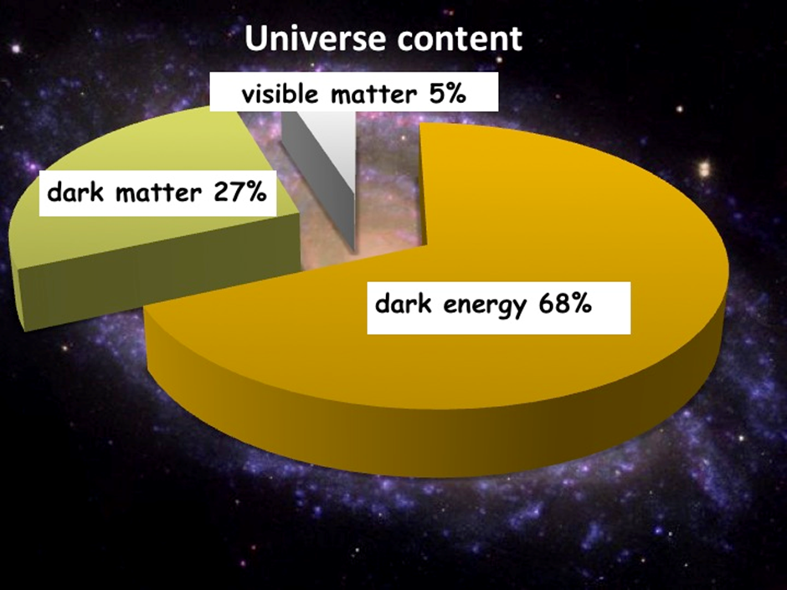
mass
mass

Slide 37
